Slide 1
Chapter 2
Network Models

Slide 2
2-1 LAYERED TASKS
We use the concept of layers in our daily life. As an example, let us consider two friends who communicate through postal mail. The process of sending a letter to a friend would be complex if there were no services available from the post office.
Topics discussed in this section:
Sender, Receiver, and Carrier Hierarchy

Slide 3
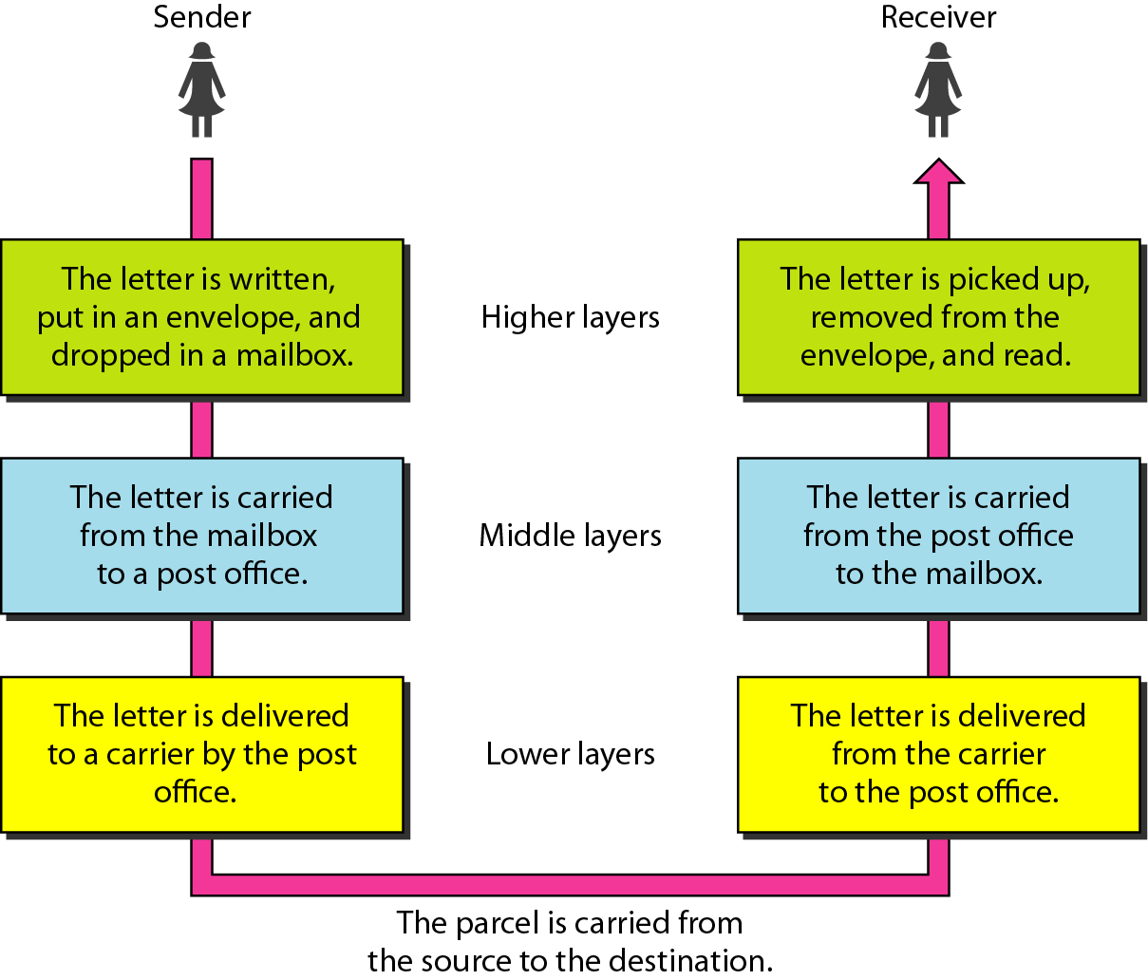
Figure 2.1 Tasks involved in sending a letter

Slide 4
2-2 THE OSI MODEL
Established in 1947, the International Standards Organization (ISO) is a multinational body dedicated to worldwide agreement on international standards. An ISO standard that covers all aspects of network communications is the Open Systems Interconnection (OSI) model. It was first introduced in the late 1970s.
Topics discussed in this section:
Layered Architecture Peer-to-Peer Processes
Encapsulation

Slide 5

Note
ISO is the organization. OSI is the model.

Slide 6
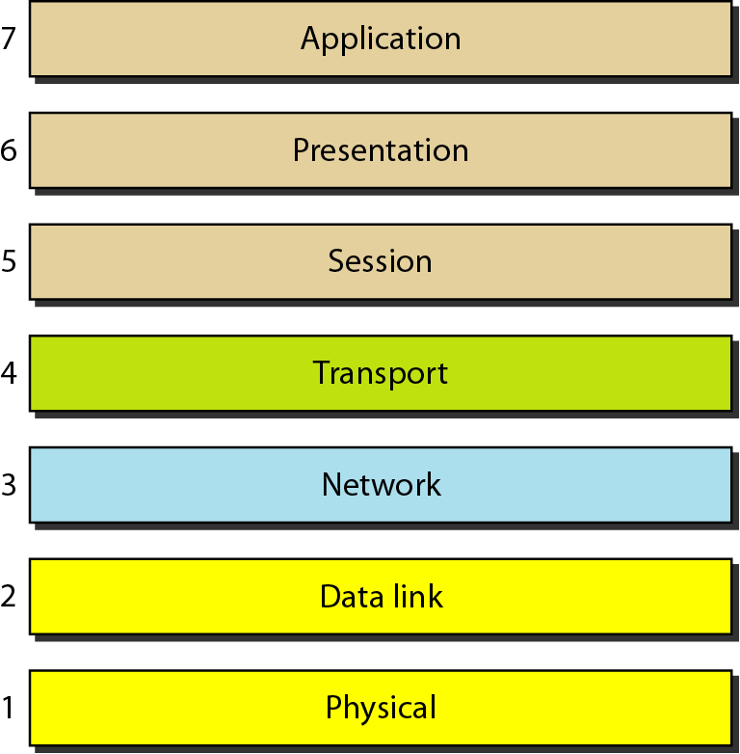
Figure 2.2 Seven layers of the OSI model

Slide 7
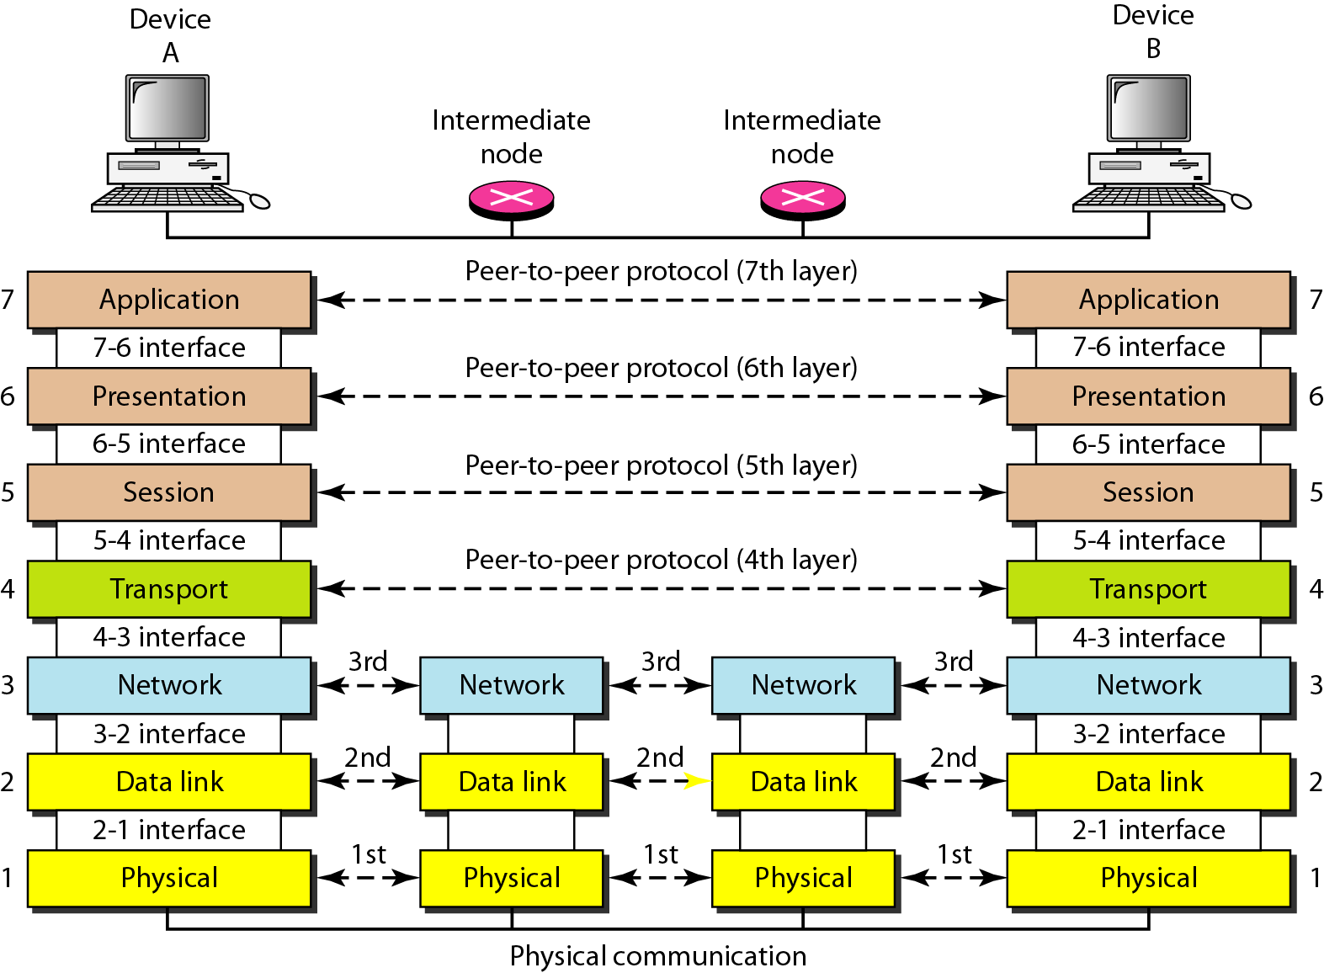
Figure 2.3 The interaction between layers in the OSI model

Slide 8
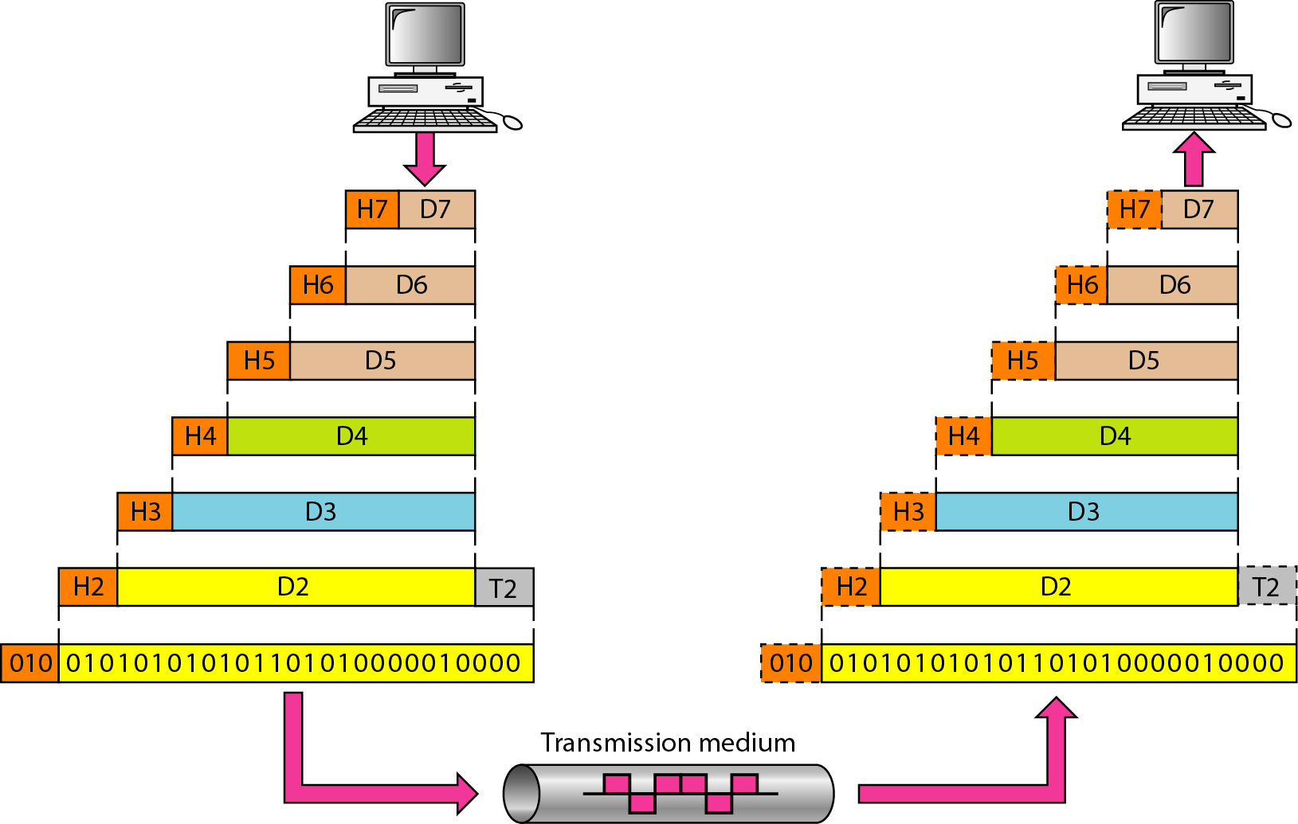
Figure 2.4 An exchange using the OSI model

Slide 9
2-3 LAYERS IN THE OSI MODEL
In this section we briefly describe the functions of each layer in the OSI model.
Topics discussed in this section:
Physical Layer Data Link Layer
Network Layer
Transport Layer
Session Layer
Presentation Layer
Application Layer

Slide 10
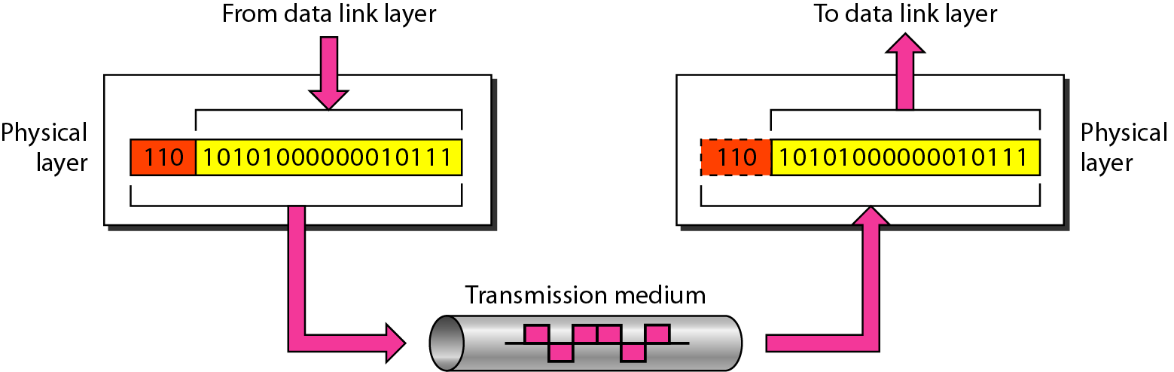
Figure 2.5 Physical layer

Slide 11
Note
The physical layer is responsible for movements of
individual bits from one hop (node) to the next.

Slide 12
The physical layer concern with the following
Physical characteristics of interface and media
Representation of bits
Data rate
Synchronization of bits
Line configuration
Physical topology
Transmission mode

Slide 13
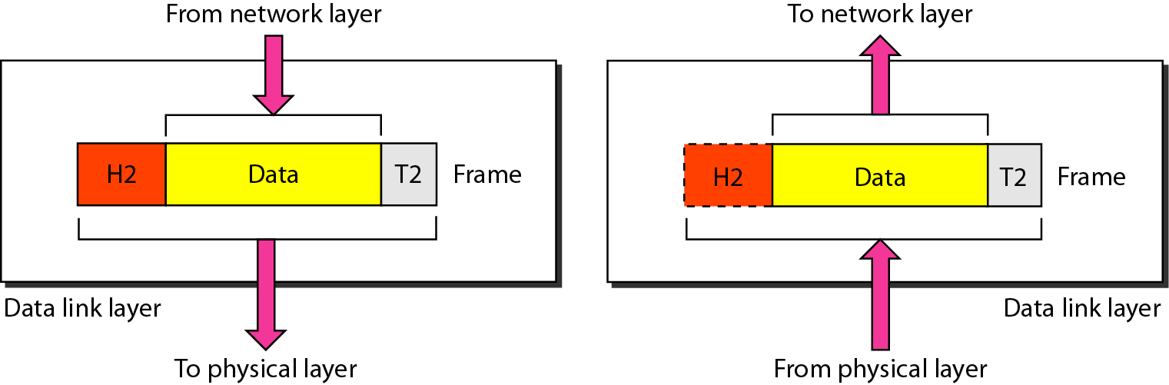
Figure 2.6 Data link layer

Slide 14
Note
The data link layer is responsible for moving frames from one hop (node) to the next.

Slide 15
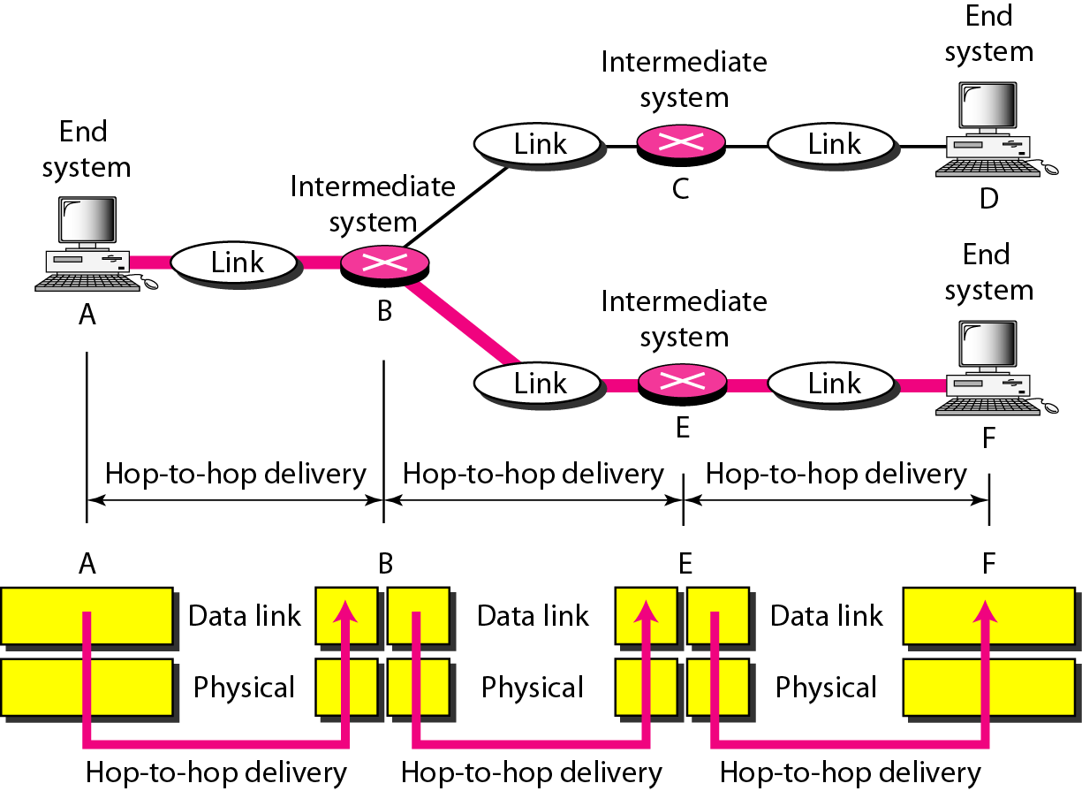
Figure 2.7 Hop-to-hop delivery

Slide 16
Responsibilities of the data link layer include the following
Framing
Physical addressing
Flow control
Error control
Access control

Slide 17
Data Link Layer Example

Slide 18
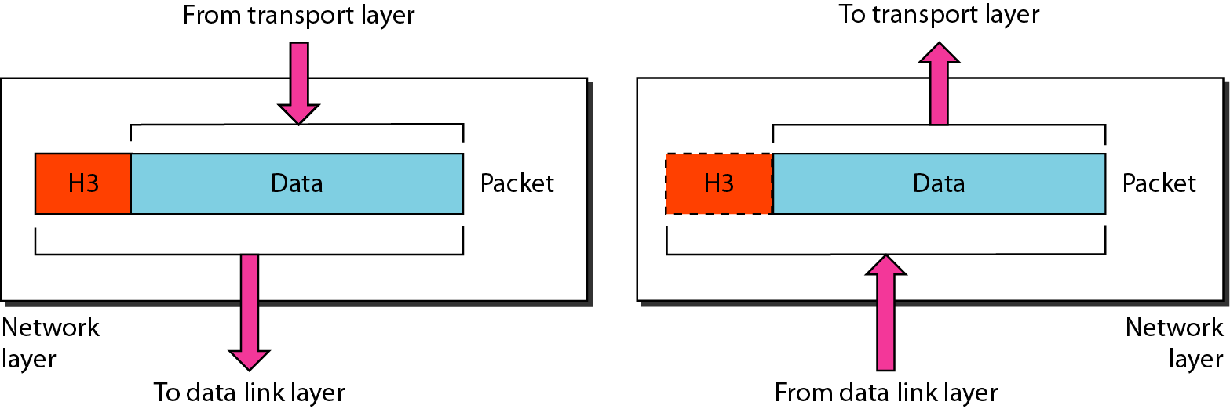
Figure 2.8 Network layer

Slide 19
Note
The network layer is responsible for the delivery of individual packets from
the source host to the destination host.

Slide 20
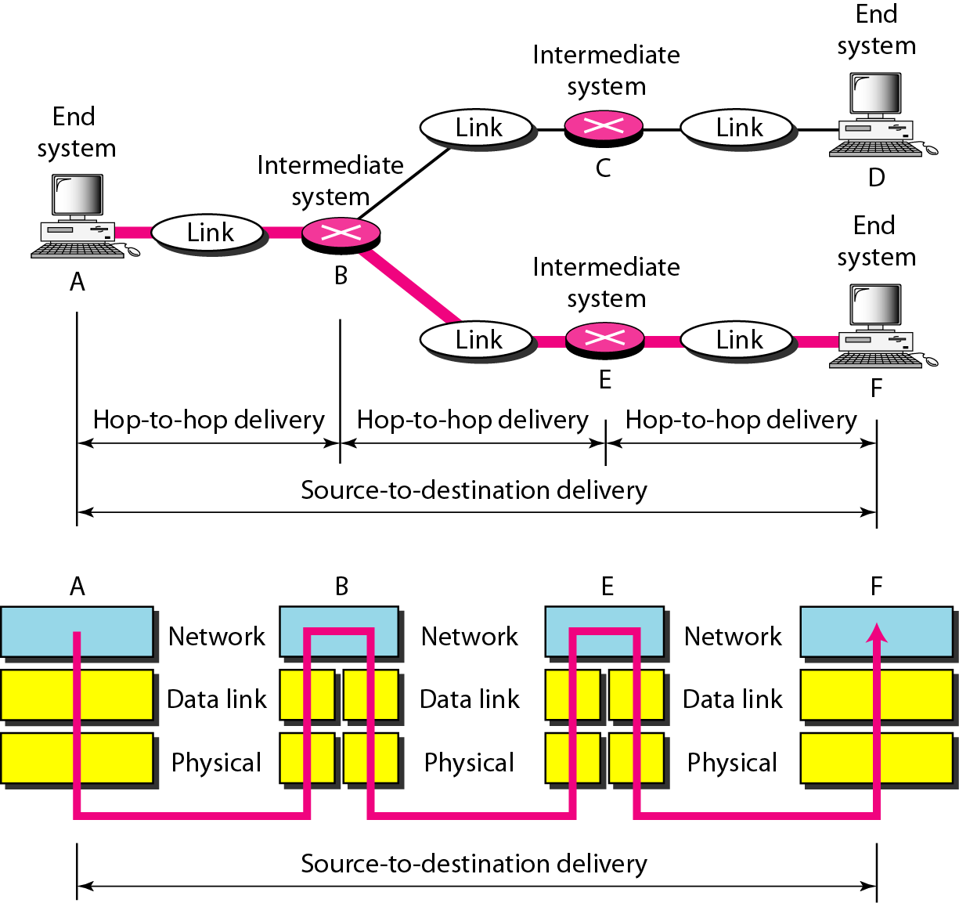
Figure 2.9 Source-to-destination delivery

Slide 21
Responsibilities of the network layer include the following
Logical addressing
Routing

Slide 22
Network Layer Example

Slide 23
Network Layer Example

Slide 24
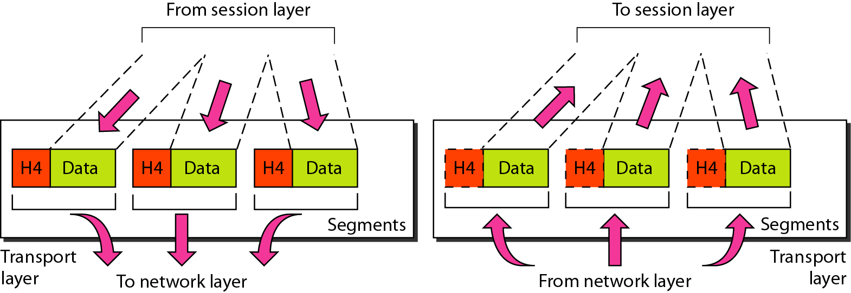
Figure 2.10 Transport layer

Slide 25
Note
The transport layer is responsible for the delivery of a message from one process to another.

Slide 26
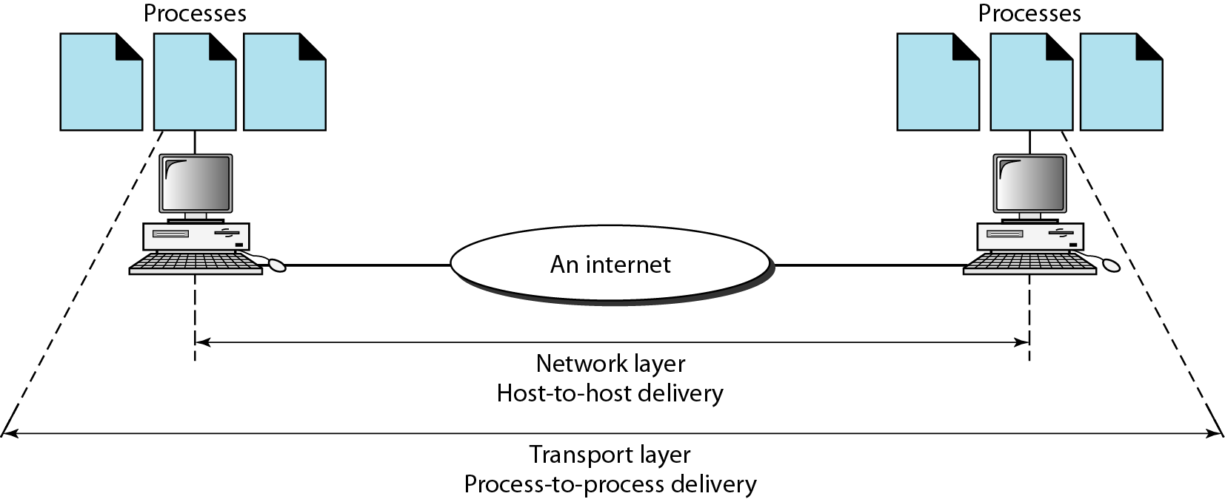
Figure 2.11 Reliable process-to-process delivery of a message

Slide 27
Responsibilities of the transport layer include the following
Service-point addressing
Segmentation and reassembly
Connection control
Flow control
Error control

Slide 28
Transport Layer Example

Slide 29
Transport Layer Example

Slide 30
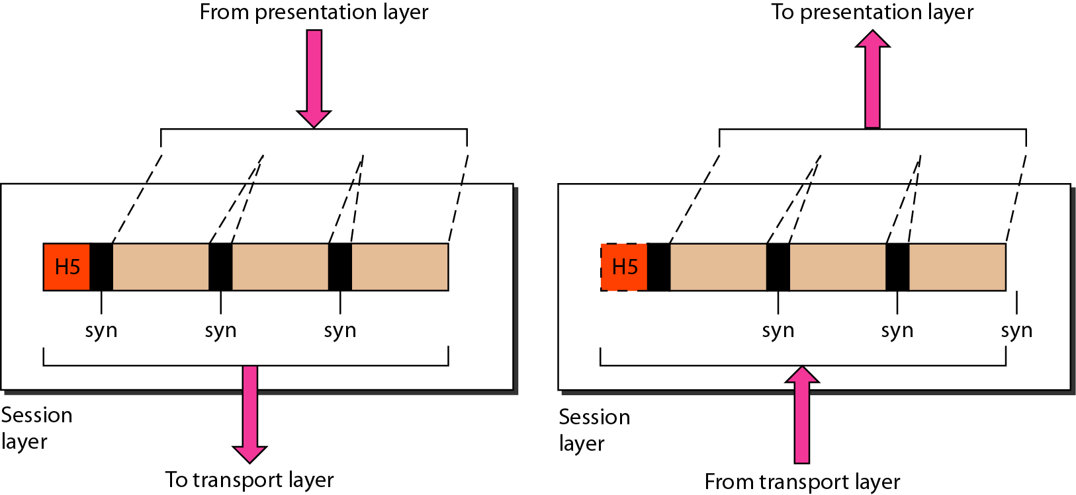
Figure 2.12 Session layer

Slide 31
Note
The session layer is responsible for dialog control and synchronization.

Slide 32
Responsibilities of the session layer include the following
Dialog control
synchronization

Slide 33
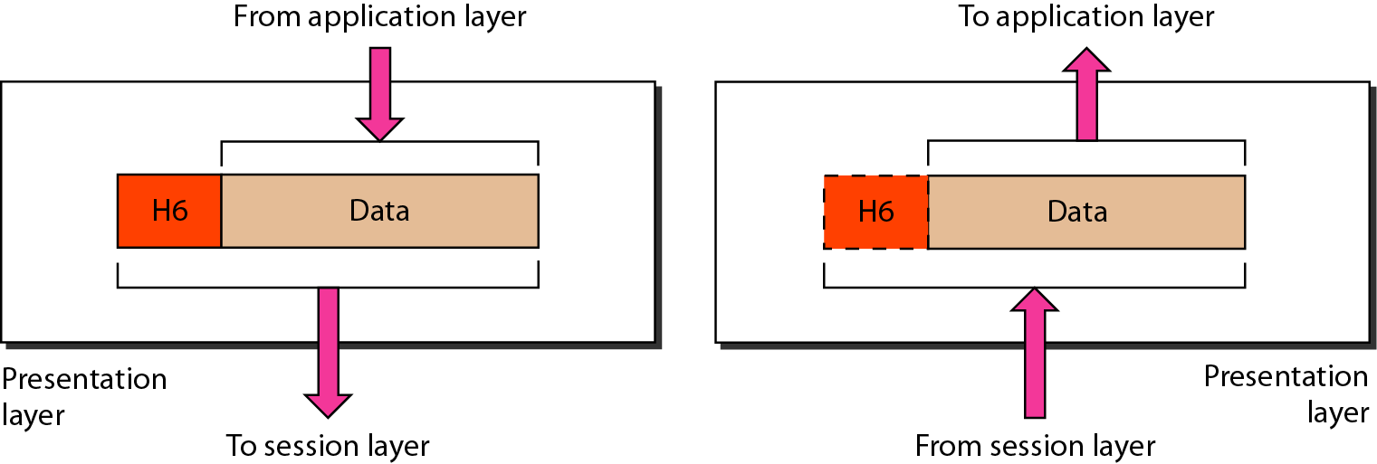
Figure 2.13 Presentation layer

Slide 34
Note
The presentation layer is responsible for translation, compression, and encryption.

Slide 35
Responsibilities of the presentation layer include the following
Translation
Encryption
Compression

Slide 36
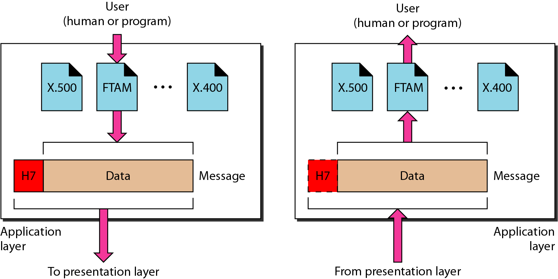
Figure 2.14 Application layer

Slide 37
Note
The application layer is responsible for providing services to the user.

Slide 38
Responsibilities of the application layer include the following
Network virtual terminal
File transfer, access, and management (FTAM)
Mail services
Directory services

Slide 39
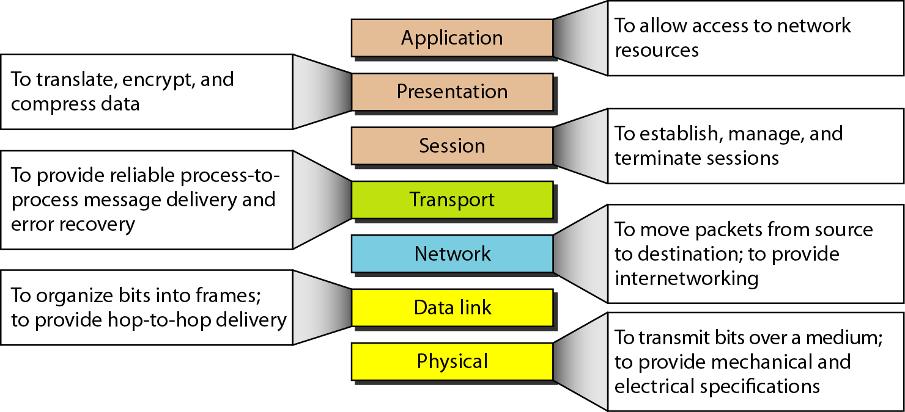
Figure 2.15 Summary of layers

Slide 40
2-4 TCP/IP PROTOCOL SUITE
The layers in the TCP/IP protocol suite do not exactly match those in the OSI model. The original TCP/IP protocol suite was defined as having four layers: host-to-network, internet, transport, and application. However, when TCP/IP is compared to OSI, we can say that the TCP/IP protocol suite is made of five layers: physical, data link, network, transport, and application.
Topics discussed in this section:
Physical and Data Link Layers Network Layer Transport Layer
Application Layer

Slide 41
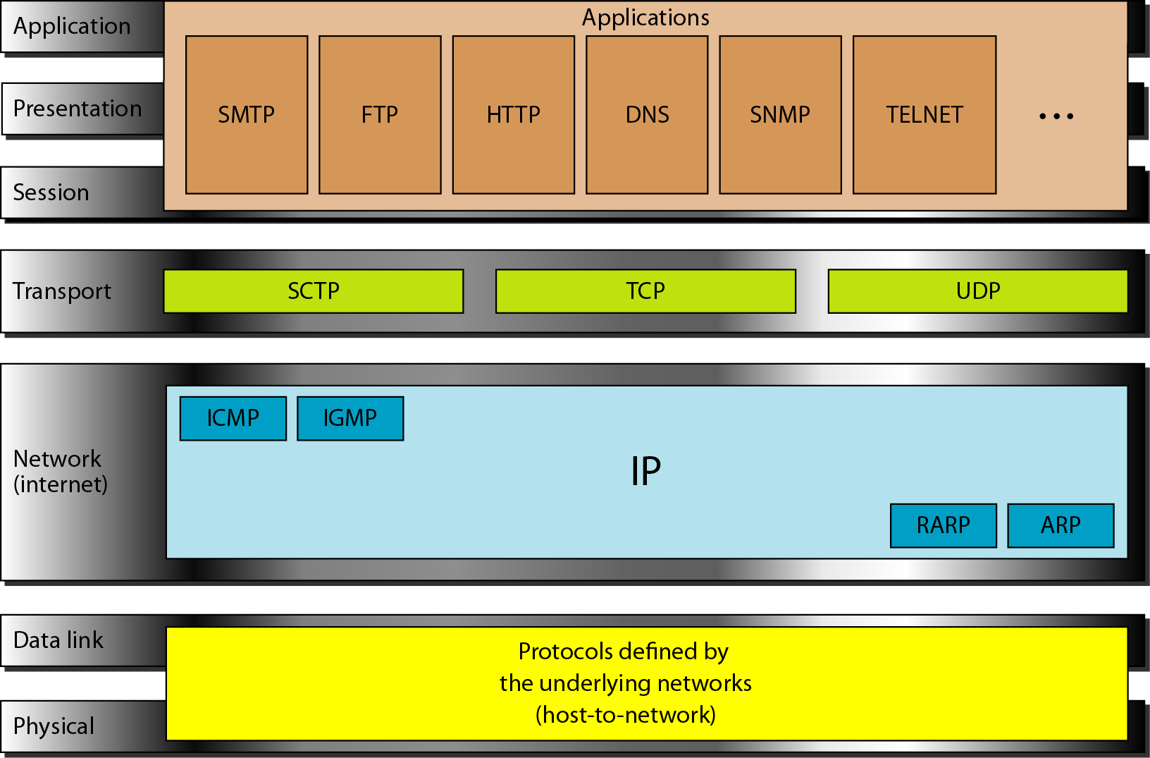
Figure 2.16 TCP/IP and OSI model

Slide 42
2-5 ADDRESSING
Four levels of addresses are used in an internet employing the TCP/IP protocols: physical, logical, port, and specific.
Topics discussed in this section:
Physical Addresses Logical Addresses Port Addresses Specific Addresses

Slide 43
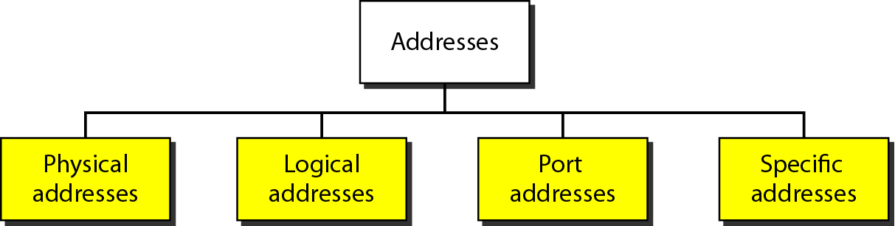
Figure 2.17 Addresses in TCP/IP

Slide 44
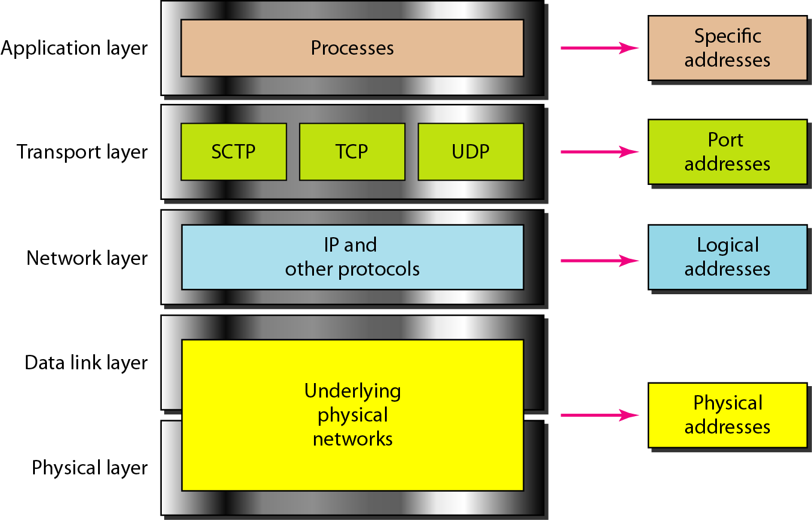
Figure 2.18 Relationship of layers and addresses in TCP/IP

Slide 45
Example 2.1
In Figure 2.19 a node with physical address 10 sends a frame to a node with physical address 87. The two nodes are connected by a link (bus topology LAN). As the figure shows, the computer with physical address 10 is the sender, and the computer with physical address 87 is the receiver.

Slide 46
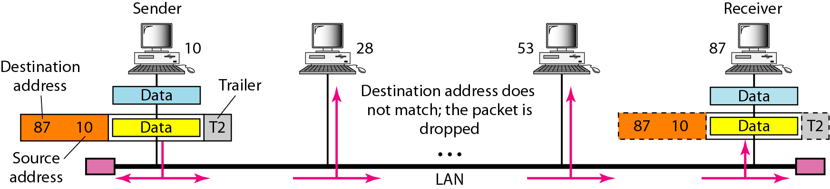
Figure 2.19 Physical addresses

Slide 47
Example 2.2
As we will see in Chapter 13, most local-area networks use a 48-bit (6-byte) physical address written as 12 hexadecimal digits; every byte (2 hexadecimal digits) is separated by a colon, as shown below:
07:01:02:01:2C:4B
A 6-byte (12 hexadecimal digits) physical address.

Slide 48
Example 2.3
Figure 2.20 shows a part of an internet with two routers connecting three LANs. Each device (computer or router) has a pair of addresses (logical and physical) for each connection. In this case, each computer is connected to only one link and therefore has only one pair of addresses. Each router, however, is connected to three networks (only two are shown in the figure). So each router has three pairs of addresses, one for each connection.

Slide 49
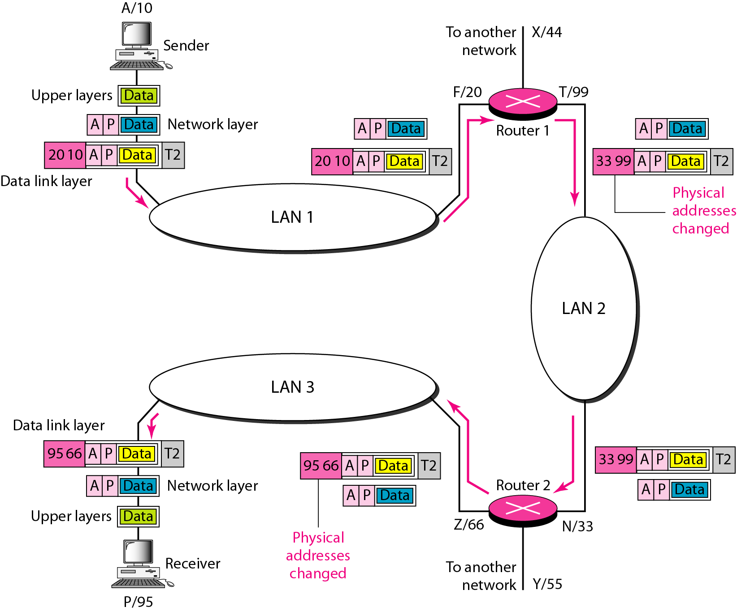
Figure 2.20 IP addresses

Slide 50
Example 2.4
Figure 2.21 shows two computers communicating via the Internet. The sending computer is running three processes at this time with port addresses a, b, and c. The receiving computer is running two processes at this time with port addresses j and k. Process a in the sending computer needs to communicate with process j in the receiving computer. Note that although physical addresses change from hop to hop, logical and port addresses remain the same from the source to destination.

Slide 51
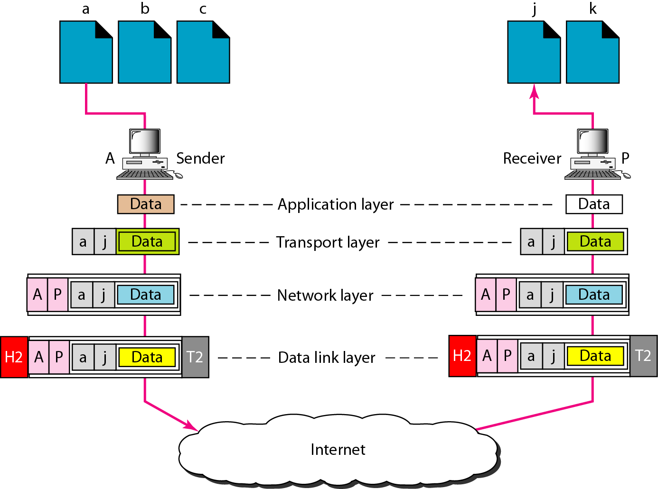
Figure 2.21 Port addresses

Slide 52
Note
The physical addresses will change from hop to hop,
but the logical addresses usually remain the same.

Slide 53
Example 2.5
As we will see in Chapter 23, a port address is a 16-bit address represented by one decimal number as shown.
753
A 16-bit port address represented as one single number.

Slide 54
Note
The physical addresses change from hop to hop,
but the logical and port addresses usually remain the same.

